Slide 1
Clinapp
Group Members – Dhruv barke(220343120022)
Ajinkya hatwar(220343120006)
punam londhe (220343120054)
Ajinkya bhutkar(220343120007)
Project Guide – Mrs. Harshita Maheshwari

Slide 2
Contents
Introduction
Choice of topic
Proposed System
Methodology
Proposed System Model
Screenshot
System Requirements
Applications
Technology Used
Advantages
Conclusion
Future Scopes

Slide 3
Introduction
A Web application for small and medium sized clinics/polyclinics.
It provides the alternative to paper used by digitizing patient record and by presenting digital prescriptions to patients.
It will be easy for patients to maintain their individual medical histories.

Slide 4
Choice of topic
Through this project doctors can manage there clinic efficiently.
Easy & Fast
Zero paper work
Reduced manual errors

Slide 5
Proposed System
AIM:
→This project will help to achieve paper less management for both
Doctors
Patients
→ Administration of the clinic will have better control over clinic
→Digitise the patient record to keep track without loss of data

Slide 6
Methodology
The objective is to create a web site that can perform the following:-
Connecting to an HTTPS site through React.
Opening the relevant HTML page using HTTPS POST & GET methods.
Read the data logically into Admin and doctor.
Creating a local database.

Slide 7
Proposed System Model
There are three main modules:
Admin Doctor Patient
1 Home 1 Home Patient History
2 Clinic Details 2 Manage Patient Details
3 Department/Doctor Details 3 Patient Prescription
4 Prescription/Patient Details 4 Employee Management
5 Log Out 5 Log Out

Slide 8
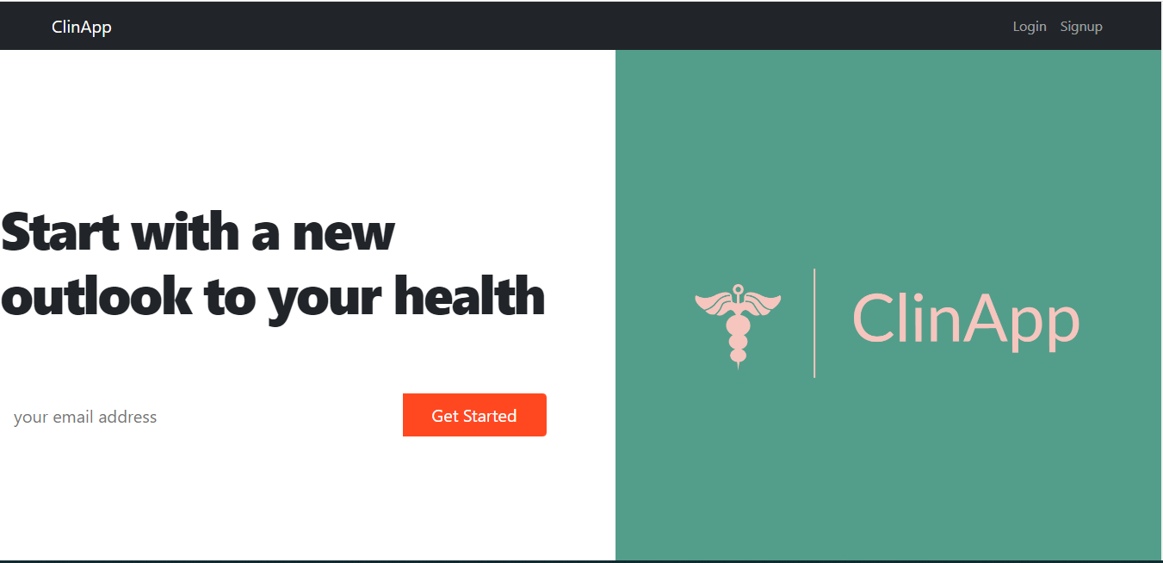
Screenshots Home Page

Slide 9
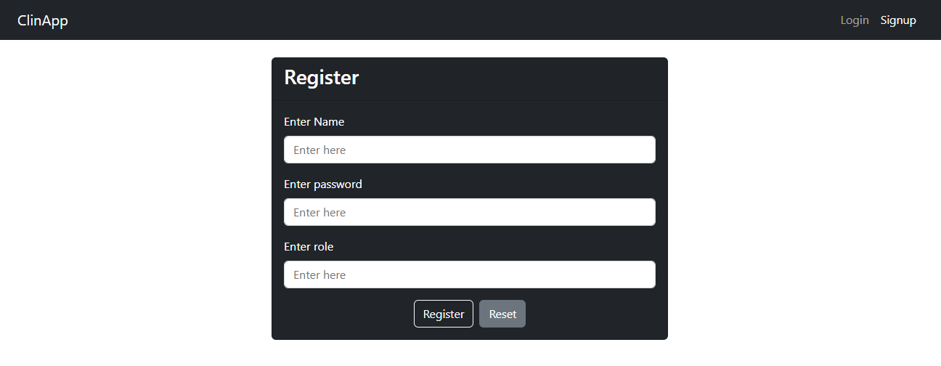
Sign up page

Slide 10
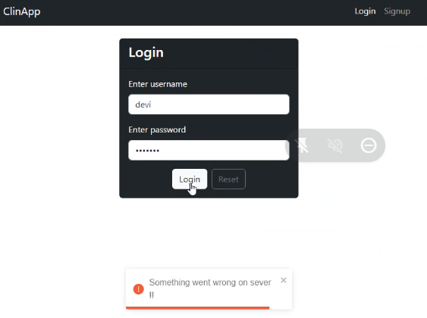
Login Form

Slide 11
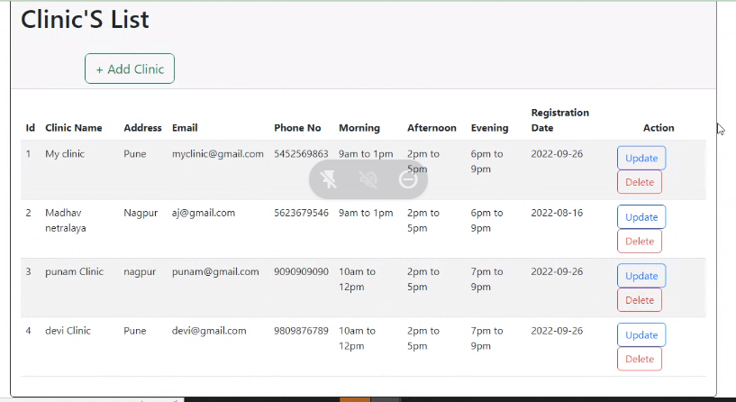
View clinic list

Slide 12
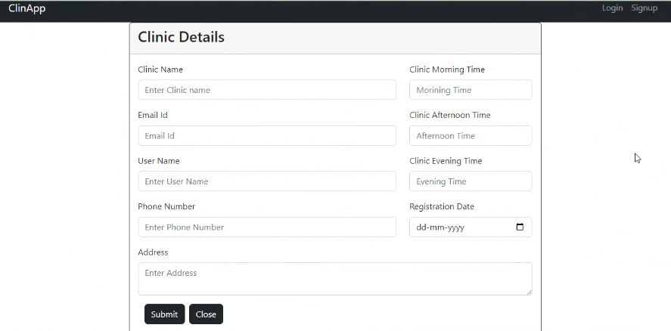

Slide 13
System Requirements
Software Requirements:
• Windows 10
• Tomcat 9
• IntelliJ, MySQL, Visual Studio Code
Hardware Components:
• Processor – i3
• Hard Disk – 500 GB
• Memory – 4GB RAM

Slide 14
Applications
Can be used by small clinics and polyclinics.
Patients to see there prescription and diagnosis.

Slide 15
Technologies Used
Spring Boot Framework : Backend logic and security provided using Spring Boot and JWT.
CSS : Used for all designing part.
JavaScript : All Validation task and animations has been developed by JS.
React : Front end development and Responsive Website Using React Components.
JAVA : All the business logic has been written in JAVA.
MySQL : MySQL database has been used as database.
Tomcat : Project will run using Tomcat server.

Slide 16
Advantages
Transparency in the system.
Saves Time, cost and energy.
Less manual errors.
No paper work involved.

Slide 17
Conclusion
The ClinApp web application is designed and developed to overcome the drawbacks of old manual system and meet the requirement of modern age for smaller clinics and polyclinics. This system will digitize the clinics save time & energy of everyone using this application. . It will bring transparency between doctors, and patients. Lastly it can be improved in future according to rising demand of users.

Slide 18
Future Scope
Can be extended for multiple clinics.
Improvement in design.
Mobile Application
Mobile OTP for registration account, sign in
Appointment
Chat BOT
Can add details of labs for various health tests.

Slide 19
References
Mr. Saleel Bagde for Database.
Mrs. Harshita Maheshwari for HTML JS & CSS also she was our project guide.
Mrs. Mayuri Fakirpure for Spring Framework & JAVA.
https://www.google.com
https://www.youtube.com
https://getbootstrap.com/
Thanks to Infoway for providing extra lab time to us

Slide 20
THANK YOU

